Slide 1



Prototype Chain and Inheritance
Prototype chain, Inheritance, Accessing Base Members
SoftUni Team
Technical Trainers
Software University
http://softuni.bg

Slide 2
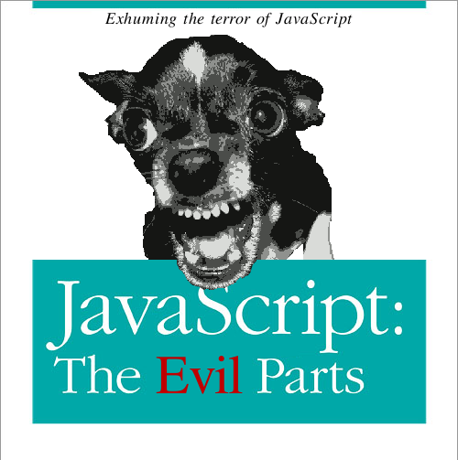
Table of Contents
The Prototype Chain
Inheritance in Classical OOP
Calling Parent Methods
Prototypal Inheritance
JavaScript OOP Frameworks
John Resig's Simple Inheritance

Slide 3

The Prototype Chain
The Way to Search Properties in JavaScript

Slide 4
Object.prototype
Property represents the Object prototype object
All JavaScript objects inherit methods / properties from prototype
Properties:
Object.prototype.constructor
Specifies the function that creates an object's prototype
Object.prototype.__proto__
Points to the object which was used as prototype (on instantiation)
Object.prototype.toString

Slide 5
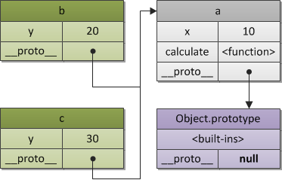
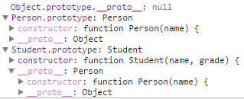
The Prototype Chain
Objects in JavaScript can have only a single prototype
Their prototype also has a prototype, etc…
This is called the prototype chain
When a property is called on an object
This object is searched for the property
If the object does not contain such property, its prototype is checked for the property, etc…
If a null prototype is reached, the result is undefined

Slide 6
Prototype Chain
null
Object.prototype
Person.prototype
key | value
constructor | Object
toString | function() { … }
valueOf | function() { … }
hasOwnProperty | function() { … }
isPrototypeOf | function() { … }
[[Prototype]] | null
key | value
constructor | Person
toString | firstName + lastName
firstName
lastName
[[Prototype]] | Object.prototype
Student.prototype
function Person(fname, lname) { … }
function Student(grade) { … }
Student.extends(Person);
var st = new Student(
"Peter", "Petrov", 4);
st.sayHello();
key | value
constructor | Student
toString | firstName + lastName + grade
grade
[[Prototype]] | Person.prototype

Slide 7
getPrototypeOf
The Object.getPrototypeOf() method returns the prototype of specified object
The value of the internal [[Prototype]] property
Don't use __proto__
It is deprecated
function Person(fname, lname) {}
var pesho = new Person('Pesho', 'Peshev');
Object.getPrototypeOf(Person); // [Function: Empty]
Object.getPrototypeOf(pesho); // Person.prototype

Slide 8
hasOwnProperty
The hasOwnProperty() method returns a boolean indicating whether the object has the specified property.
Every object inherits the hasOwnProperty method
Does not traverse the prototype chain.
Use hasOwnProperty instead of traversing the properties
var obj = {};
obj.name = 'My Object';
obj.hasOwnProperty('name'); // returns true
obj.hasOwnProperty('age'); // returns false

Slide 9
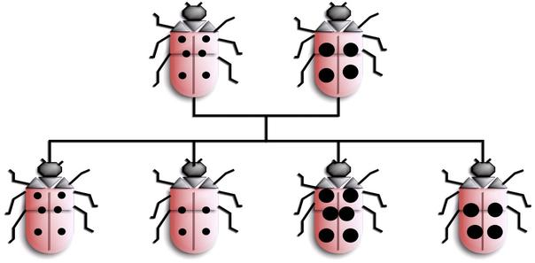
Inheritance in Classical OOP
Like in C#, Java or C++

Slide 10
Inheritance in Classical OOP
Inheritance is a way to extend the functionality of an object
Like Student inherits Person
In JavaScript inheritance is achieved by setting the prototype of the derived type to an instance of the super type
Now Student objects are also of type Person
function Person(fname, lname) {}
function Student(fname, lname, grade) {}
Student.prototype = new Person();
var student = new Student("Kiro", "Troikata", 7);

Slide 11


How to Inherit the prototype Object?
Student.prototype = Person.prototype;
Didn't work! Both refer to same object
Adding something to Child.prototype, will be added to Parent.prototype
Student.prototype = new Person();
This invokes the constructor which might have undesired side effects
Student.prototype = Object.create(Person.prototype);
Set prototype to the new object, created from Person's prototype
Set back the constructor of prototype pointing to Student constructor
Student.prototype = Object.create(Person.prototype);
Student.prototype.constructor = Student;

Slide 12
Adding extends method
We can add extension method to Object
Which gets parent as parameter
Which sets the prototype of the child to the prototype of the parent
Which return reference of the child prototype to the child constructor
Object.prototype.extends = function (parent) {
this.prototype = Object.create(parent.prototype);
this.prototype.constructor = this;
}

Slide 13
Fixing Missing Object.create(…)
Modern browsers already have Object.create(…)
Easy to be fixed for all browsers:
if (!Object.create) {
Object.create = function (proto) {
function F() {};
F.prototype = proto;
return new F();
};
};

Slide 14
Inheritance in Classical OOP
Live Demo

Slide 15
Inheritance in Classical OOP - Diagram
Object.prototype [[Object]]
constructor | Object()
[[Prototype]] | null
Object [[Function]]
prototype | Object.prototype
Person.prototype [[Object]]
constructor | Person()
[[Prototype]] | Object.prototype
Person [[Function]]
prototype | Person.prototype
name | "Person"
length | 1
pesho
firstName | Peter
[[Prototype]] | Student.prototype
Student [[Function]]
prototype | Student.prototype
name | "Student"
length | 2
Student.prototype [[Object]]
constructor | Student()
[[Prototype]] | Person.prototype

Slide 16
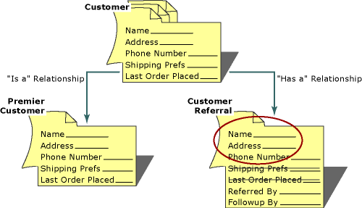
Calling Parent Methods
Reusing Logic from the Inherited Class

Slide 17
Calling Parent Methods
JavaScript has no direct way of calling its parent methods
Function constructors actually does not who or what is their parent
Calling parent methods is done using call(…) and apply(…)

Slide 18
Calling Parent Methods: Example
Define a Shape class
var Shape = (function () {
function Shape(x, y) {
// Initialize the shape
}
Shape.prototype = {
serialize: function () {
// Serialize the shape // Return the serialized
}
};
return Shape;
}());

Slide 19
Calling Parent Methods: Example (2)
var Rect = (function () {
function Rect(x, y, width, height) {
Shape.call(this, x, y);
this.witdh = width;
this.height = height;
}
Rect.prototype = Object.create(Shape.prototype);
Rect.prototype.serialize = function (){
Shape.prototype.serialize.call(this);
// add Rect-specific serialization
// and return the serialized rectangle
};
return Rect;
}());
Calling the parent constructor
Rect inherits Shape
Calling the parent serialize() function

Slide 20
Calling Parent Methods
Live Demo

Slide 21

Prototypal Inheritance
Another Way to Work with Classes in JS

Slide 22
Prototypal Inheritance
Prototypal inheritance is not like the classical inheritance
All instances are created from a common JS object
instanceof does not work
var person = {
init: function(name, age) {
this._name = name;
this._age = age;
},
introduce: function() {
return this.name + " " + this.age;
}
}
var student = Object.create(person);
student.init('Pesho', 19);

Slide 23
Prototypal Inheritance (2)
var person = {
init: function init(name, age) {
this.name = name;
this.age = age;
return this;
},
introduce: function introduce() {
return this.name + " " + this.age;
}
};
var student = Object.create(person);
student.init = function init(name, age, grade) {
person.init.call(this, name, age);
this.grade = grade;
return this;
}
Call person's init() method

Slide 24
Prototypal Inheritance – Extend method
Extend the Person object and add Student specific functionality
Set the prototype to this of the extended object
Object.prototype.extend = function(properties) {
function f() {};
f.prototype = Object.create(this);
for (var prop in properties) {
f.prototype[prop] = properties[prop];
}
f.prototype._super = this;
return new f();
}
Add the derived object properties
Keep a reference to the super object
var person = { init: function(name) { this.name = name; } }
var student = person.extend({
init: function init(name, grade) {
this._super.init.call(this, name);
this.grade = grade;
return this;
}
});

Slide 25
Prototypal Inheritance
Live Demo

Slide 26
Inheritance in Prototypal OOP - Diagram
Object.prototype [[Object]]
constructor | Object()
[[Prototype]] | null
Object [[Function]]
prototype | Object.prototype
person [[Object]]
init | personInit()
[[Prototype]] | Object.prototype
personInit [[Function]]
prototype | …
name | "Person"
length | 1
pesho
firstName | Peter
__proto__ | Student.prototype
studentInit [[Function]]
prototype | …
name | "studentInit"
length | 2
student [[Object]]
init | studentInit()
[[Prototype]] | Object.prototype

Slide 27
Constructor Pattern vs Prototypal Pattern
Constructor Pattern
Functional features can't be used in conjunction with the new keyword
Forgetting to use new leads to unexpected bugs and global variables
Prototypal inheritance is unnecessarily complicated and confusing
Most programmers will understand your code
Prototypal Pattern
Functional features can be used in conjunction with create
Since init is a function the program will always work as expected
Prototypal inheritance is simple and easy to understand

Slide 28

OOP Frameworks for JavaScript

Slide 29
JS OOP Frameworks
OOP is a primary design paradigm in most programming languages
Yet, OOP in JavaScript is not that perfect
CofeeScript and TypeScript have better OOP
And that is why every framework has its own way of doing OOP
YUI, Prototype.js, Backbone.js, etc…
If none of these frameworks is used, a simple implementation by John Resig is intruded

Slide 30
John Resig's Simple Inheritance
http://ejohn.org/blog/simple-javascript-inheritance/
var Shape = Class.extend({
init: function(x, y) {
this._x = x;
this._y = y;
},
serialize: function() {
return {
x: this._x,
y: this._y
};
}
});
Create a class
init() function is required

Slide 31
John Resig Simple Inheritance
Inherit Shape
var Rect = Shape.extend({
init: function(x, y, w, h) {
this._super(x, y);
this._width = w;
this._height = h;
},
serialize: function() {
var res = this._super();
res.width = this._width;
res.height = this._height;
return res;
}
});
Calling the parent constructor
Calling the parent serialize()

Slide 32

John Resig's Simple Inheritance
Live Demo

Slide 33







Advanced JavaScript
https://softuni.bg/courses/advanced-javascript

Slide 34
License
This course (slides, examples, demos, videos, homework, etc.) is licensed under the "Creative Commons Attribution-NonCommercial-ShareAlike 4.0 International" license
Attribution: this work may contain portions from
“JavaScript OOP" course by Telerik Academy under CC-BY-NC-SA license

Slide 35





Free Trainings @ Software University
Software University Foundation – softuni.org
Software University – High-Quality Education, Profession and Job for Software Developers
softuni.bg
Software University @ Facebook
facebook.com/SoftwareUniversity
Software University @ YouTube
youtube.com/SoftwareUniversity
Software University Forums – forum.softuni.bg

